Slide 1




Predictive Analytics
By RENZO BEJARANO VARELA
This Photo by Unknown Author is licensed under CC BY-SA-NC

Slide 2
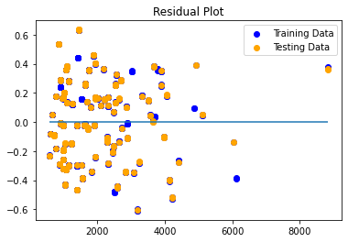
PROCESS OVERVIEW
A regression line is simply calculating a line that best fits the data. This is typically done through the least squares method where the line is chosen to have the smallest overall distance to the points.
Multiple Linear Regression:
We have more than one feature variable.
Because we can't easily plot our line in 3D space,
we can use a residual plot to check our predictions.
𝑦 is the output response(Annual Salary)
𝑥1 is the input feature(age)
𝑥2 is the input feature(gender)
𝑥3 is the input feature(Balance)
𝜃0θ0 is the y-axis intercept
𝜃1θ1,etc is weight coefficient (slope)
𝑦=𝜃0+𝜃1𝑥1+𝜃2𝑥2+𝜃3𝑥3
Residuals are the difference between the true values of y and the predicted values of y.
We want our predictions to be close to zero on the y-axis in this plot.

Slide 3
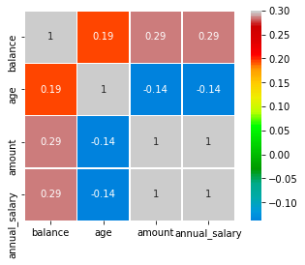
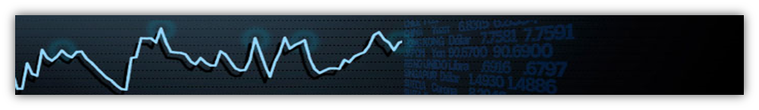
GENERAL FINDINGS
According the correlation matrix, there is a strong correlation between annual salary and transaction amount , as well as average transaction amount. People with high income tend to have high transaction amount.
On the other hand, the regression plot of Annual Salary against Age shows a negative correlation.

Slide 4

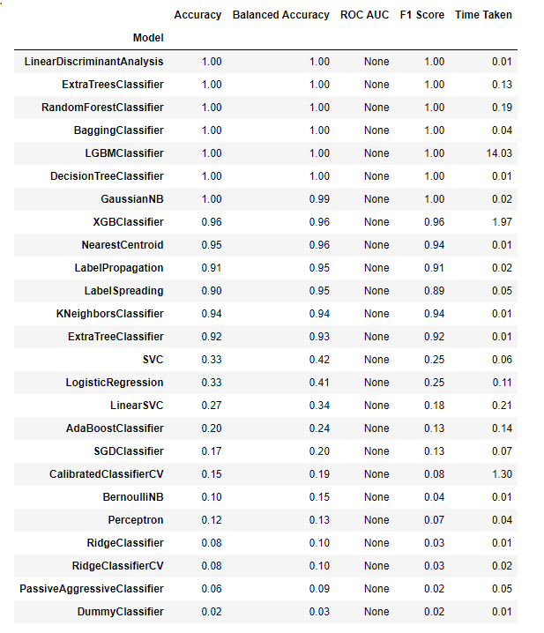
CONCLUSIONS
Voilá. You just iterated over 29 models in less than 20 seconds.
We got a very similar result. It seems that the results are trustworthy. Specially for LinearDiscriminantAnalysis,ExtraTreesClassifier,RandomForestClassifier,BaggingClassifier,LGBMClassifier,DecisionTreeClassifier and GaussianNB models.
Based on the features selected and the models, it can be concluded that the Linear Regression model performed very similar than the Decision Tree model as F1-score, is a measure of a model's accuracy on a dataset, are for both cases 1.
However, I strongly believe that better features can be selected and a more data points can be added improve the integrity and accuracy of the models

